Slide 1
Loss Function and Optimization
CS5330, Huaizu Jiang
Fall 2021, Northeastern University

Slide 2
Announcement
GPU resources for the final project
Discovery (your account should be ready to use)
try ssh <nu username>@login.discovery.neu.edu
Documentation of Discovery: https://rc-docs.northeastern.edu/en/latest/
AWS
Google could
Office hour of Prajanan (only this week)
Friday, 2-3pm -> Sunday, 10-11pm
Make-up Office Hour by me (only this week)
Friday, 2-3pm
Project proposal abstract due on Nov 1 (next Monday)

Slide 3
Recap

Slide 4
Machine Learning vs Programming
Traditional Programming
Human
“Software 1.0”
Input
Algorithm
Output
Machine Learning
Human
“Software 2.0”
Data
Algorithm
Input
Model
Output
https://medium.com/@karpathy/software-2-0-a64152b37c35
Slide credit: D Fouhey & J Johnson

Slide 5
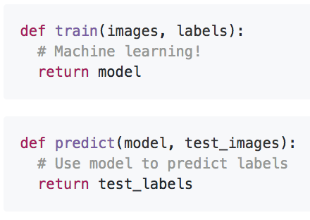
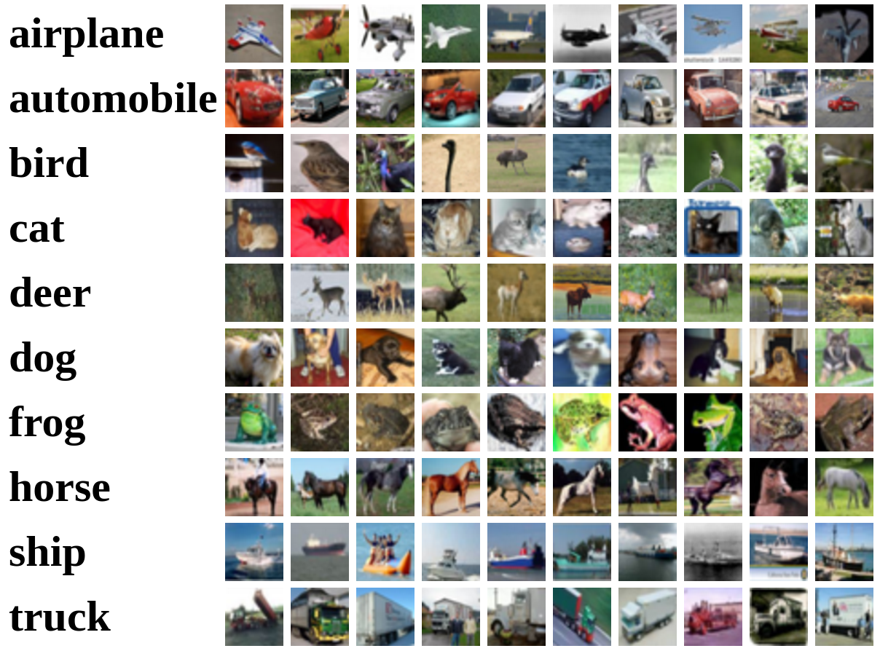
Machine Learning: Data-Driven Approach
Collect a large set of data
Use Machine Learning to train a model
Evaluate the model on new data
Example training set
Slide credit: D Fouhey & J Johnson

Slide 6
ML Problems in Vision
Supervised
(Inputs+Labels)
Unsupervised
(Just Data)
Discrete
Output
Classification/
Categorization
Clustering
(Object detection,
image segmentation)
Continuous
Output
Dimensionality
Reduction
Regression
(stereo disparity,
optical flow)
Slide adapted from J. Hays

Slide 7
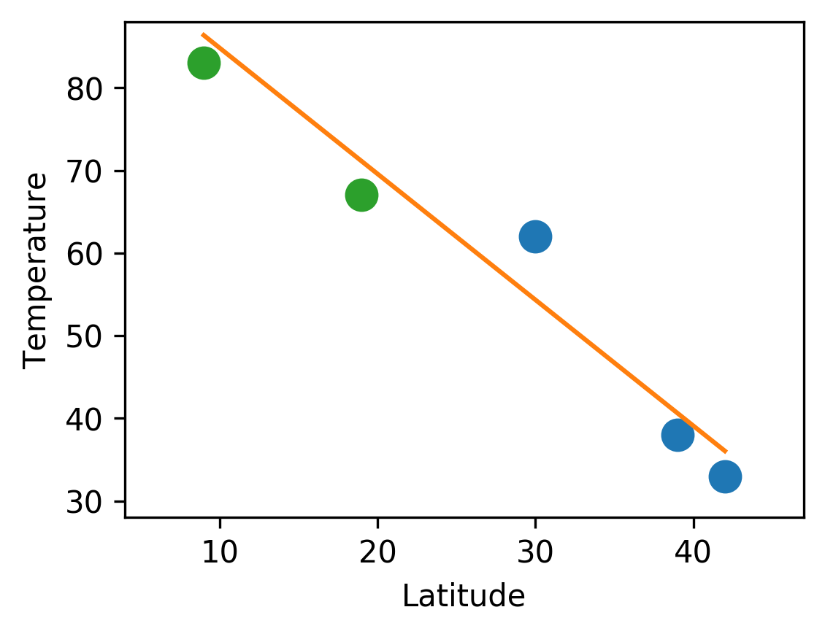
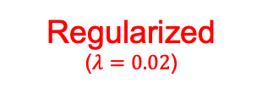
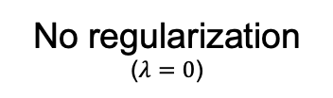
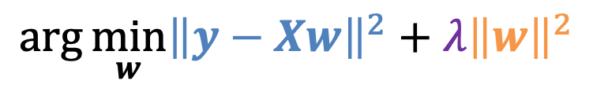
Regularization
No regularization
($λ=0$)
Regularized
($λ=0.02$)
City
Latitude (°)
Temp (F)
Prediction
Error
Prediction
Error
Ann Arbor
42
33
1.0
31.9
1.0
36.0
3.0
Train
Washington, DC
39
38
39.4
1.4
40.6
2.6
Austin, TX
30
62
61.7
0.3
54.3
7.7
Mexico City
19
67
88.9
21.9
71.1
4.1
Test
Panama City
9
83
113.6
30.6
86.4
3.4
L2-Regularized Least Squares
$$\arg{\min_{w}{{\left\|y−Xw\right\|}^{2}+{λ\left\|w\right\|}^{2} }}$$
Fit training data
Regularization Strength
Penalize complexity
Slide credit: D Fouhey & J Johnson

Slide 8
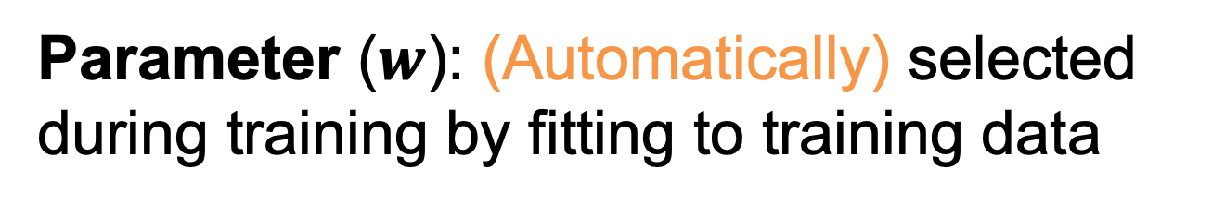
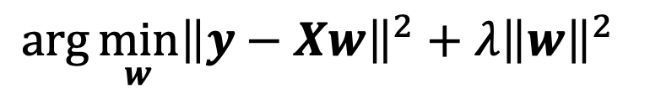
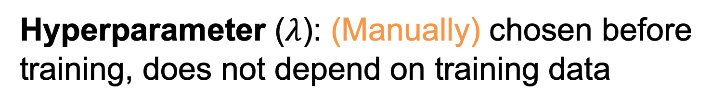
Parameters and Hyperparameters
L2-Regularized Least Squares
$$\arg{\min_{w}{{\left\|y−Xw\right\|}^{2}+{λ\left\|w\right\|}^{2} }}$$
Parameter ($w$): (Automatically) selected during training by fitting to training data
Hyperparameter ($λ$): (Manually) chosen before training, does not depend on training data
Question: How to choose hyperparameters?
Slide credit: D Fouhey & J Johnson

Slide 9
Choosing Hyperparameters
Idea #1: Choose hyperparameters that work best on the data
BAD: λ =0 always works best on training data
Your Dataset
Idea #2: Split data into train and test, choose hyperparameters that work best on test data
BAD: No idea how we will perform on new data
train
test
Idea #3: Split data into train, val, and test; choose hyperparameters on val and evaluate on test
Better!
train
validation
test
Slide credit: D Fouhey & J Johnson

Slide 10
Choosing Hyperparameters
Your Dataset
Idea #4: Cross-Validation: Split data into folds, try each fold as validation and average the results
fold 1
fold 2
fold 3
fold 4
fold 5
test
fold 1
fold 2
fold 3
fold 4
fold 5
test
fold 1
fold 2
fold 3
fold 4
fold 5
test
Useful for small datasets, but (unfortunately) not used too frequently in deep learning
Slide credit: D Fouhey & J Johnson

Slide 11
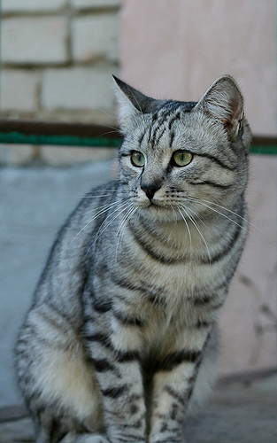
Image Classification: Core Vision Task
Input: image
Output: Assign image to one of a fixed set of categories
cat bird deer dog
truck
This image by Nikita is licensed under CC-BY 2.0
Slide credit: D Fouhey & J Johnson

Slide 12
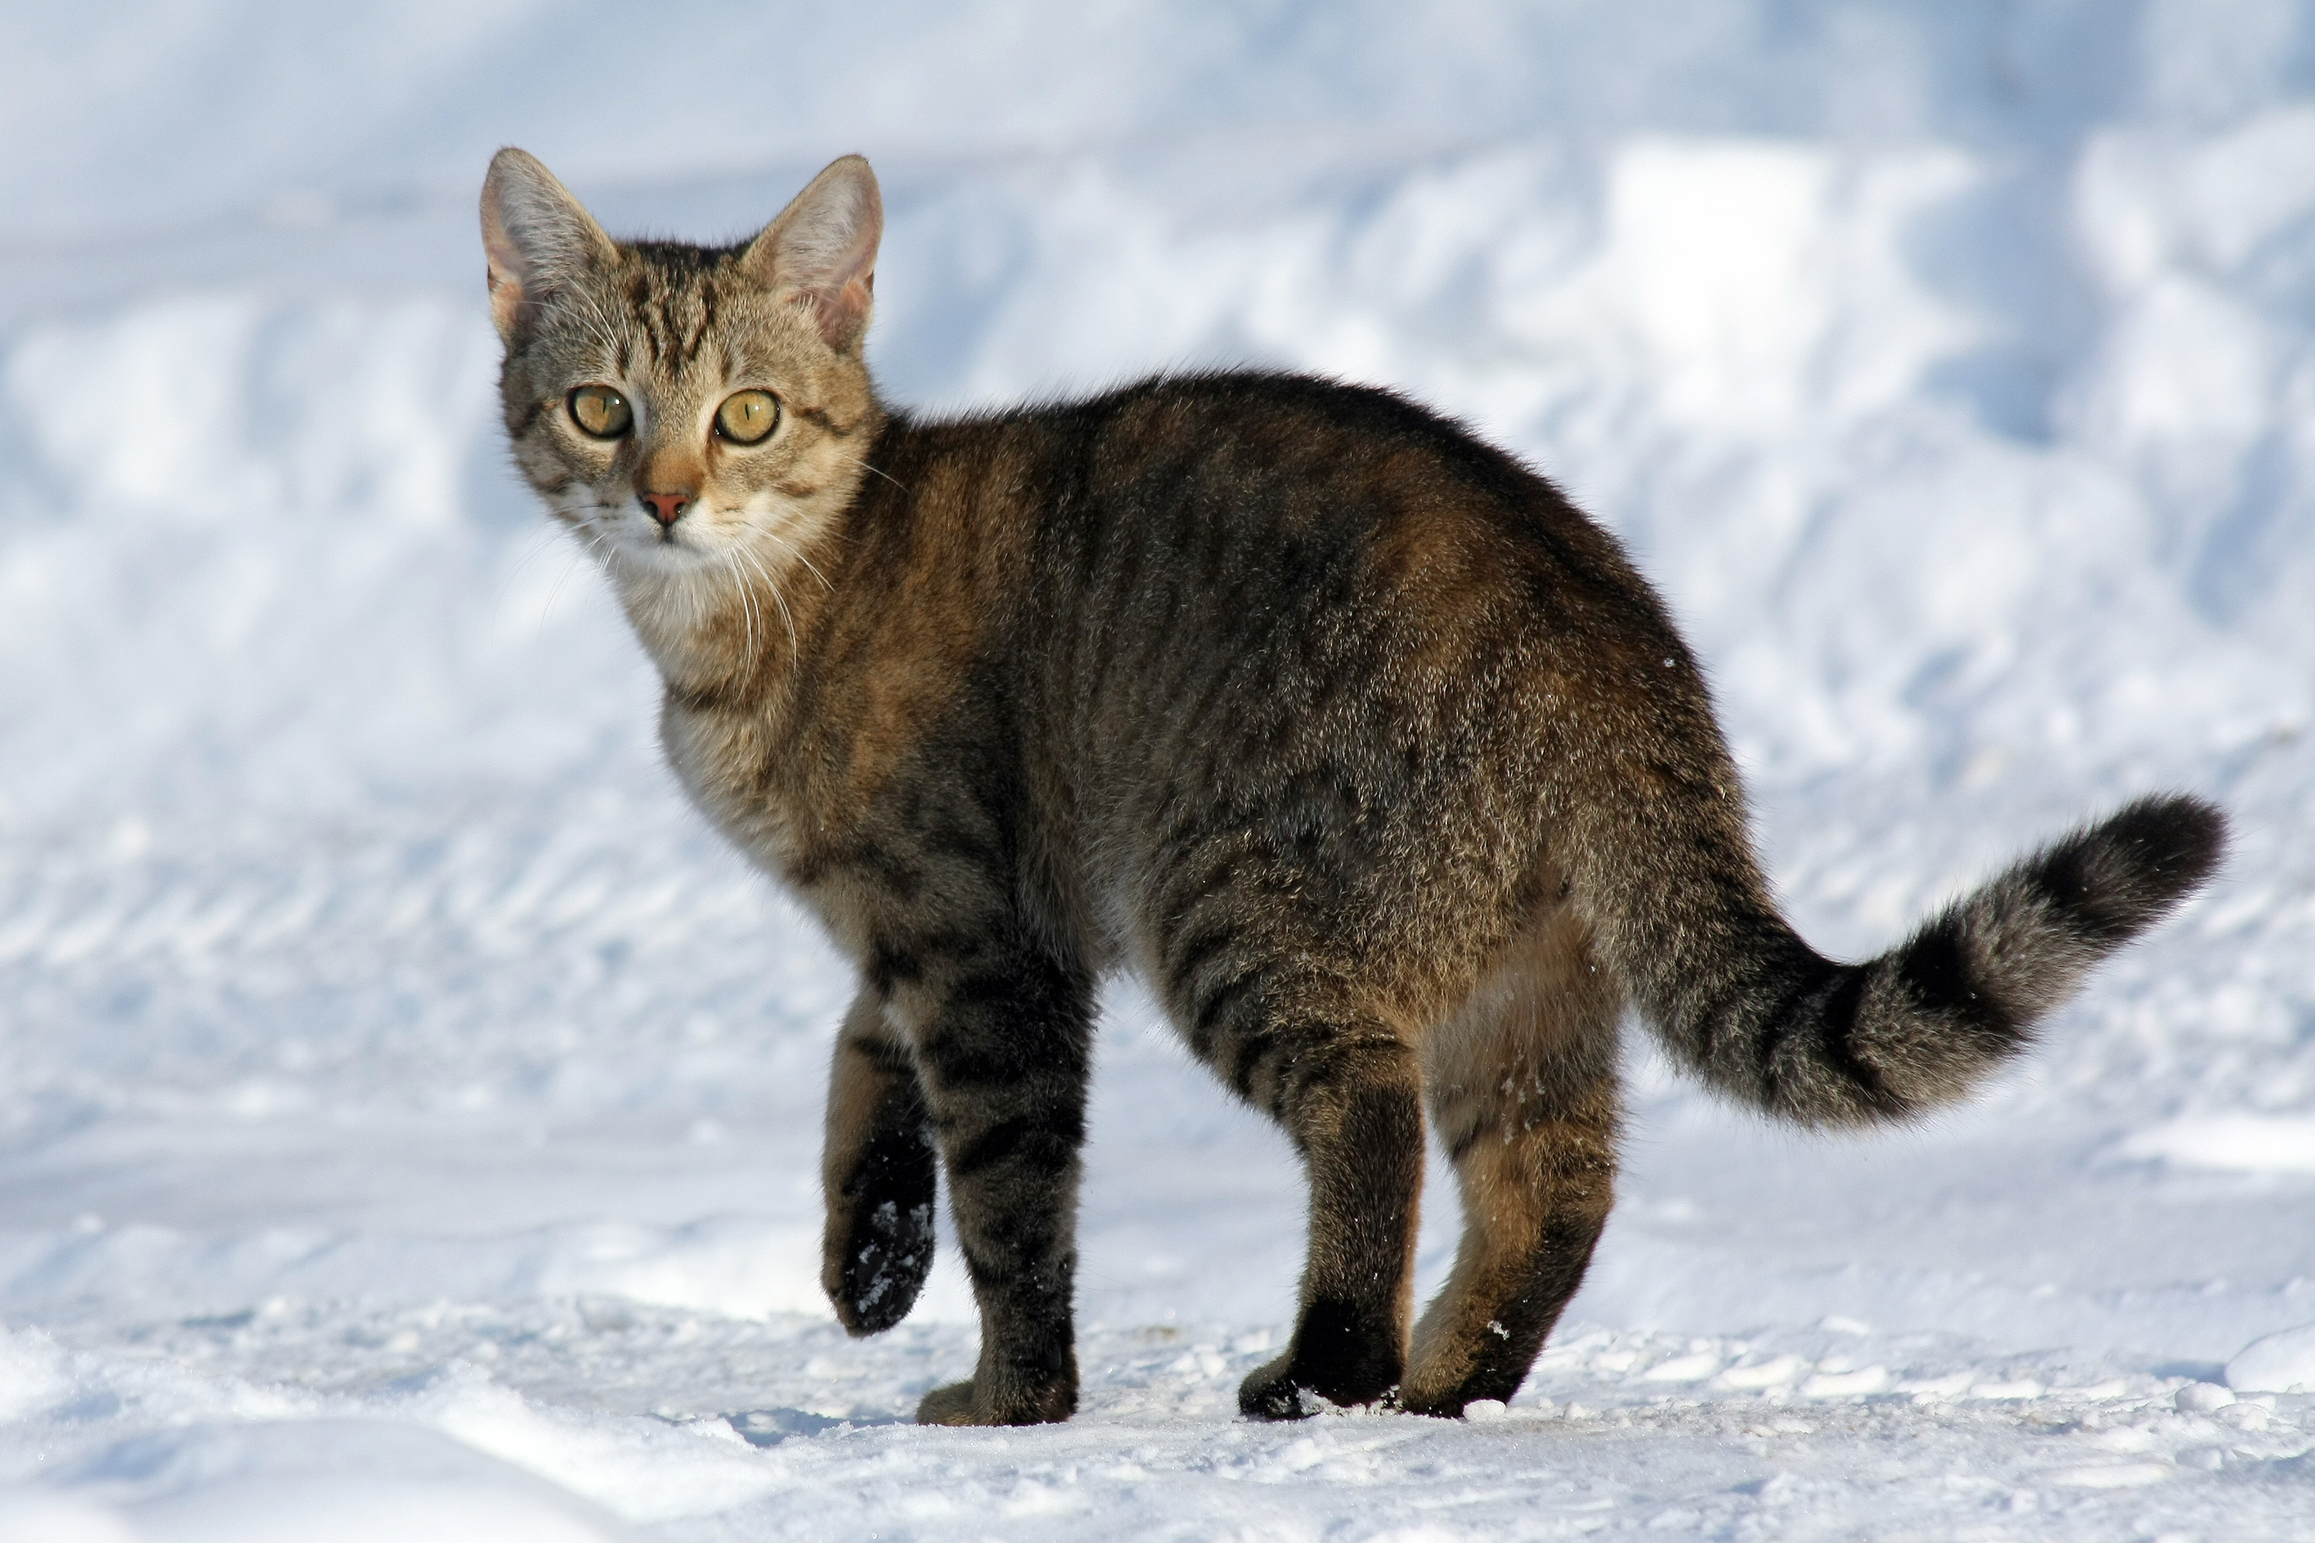
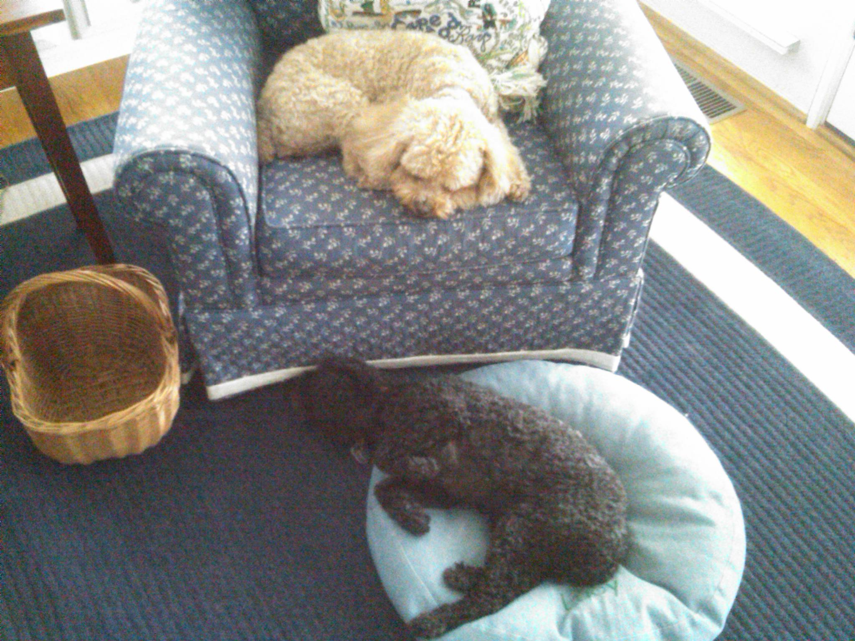
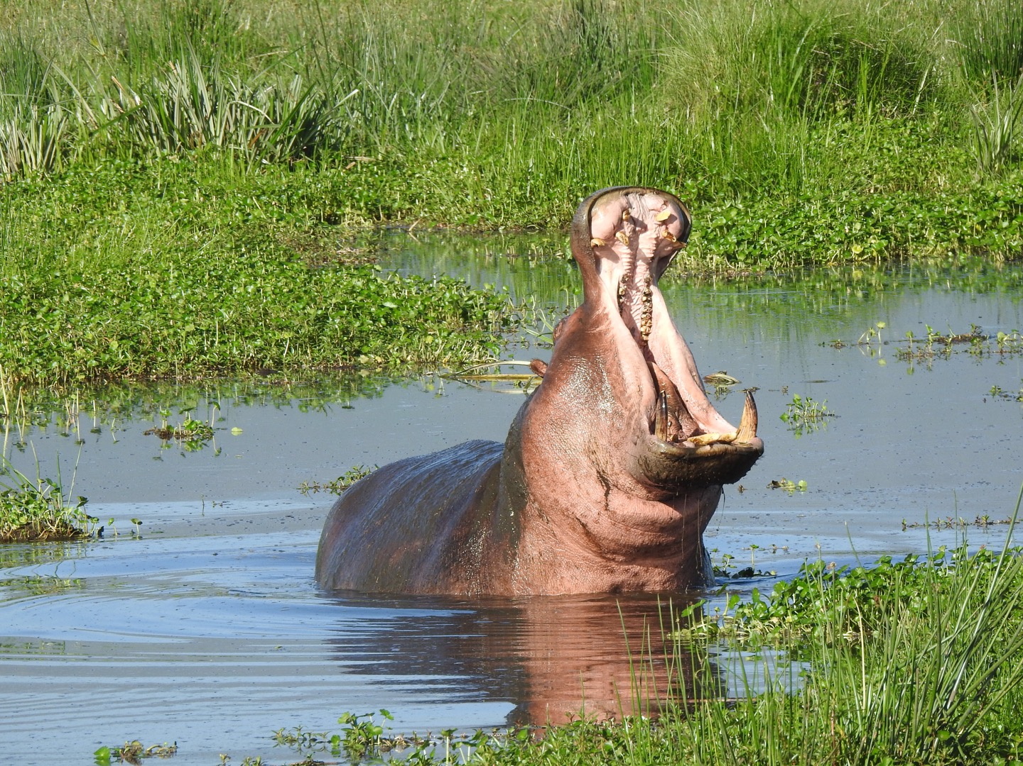
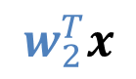
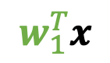

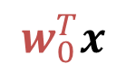
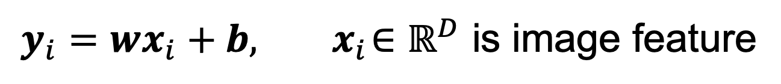
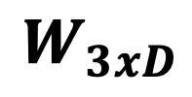
Linear Classifiers
$y_{i}=wx_{i}+b, { x}_{i}∈ℝ^{D}$ is image feature
Model – one weight per class:
$$w_{0},w_{1}, w_{2}$$
$$w_{0}^{T}x$$
big if cat
$$w_{1}^{T}x$$
big if dog
$$w_{2}^{T}x$$
big if hippo
Stack together:
$$W_{3xD}$$
Slide credit: D Fouhey & J Johnson

Slide 13
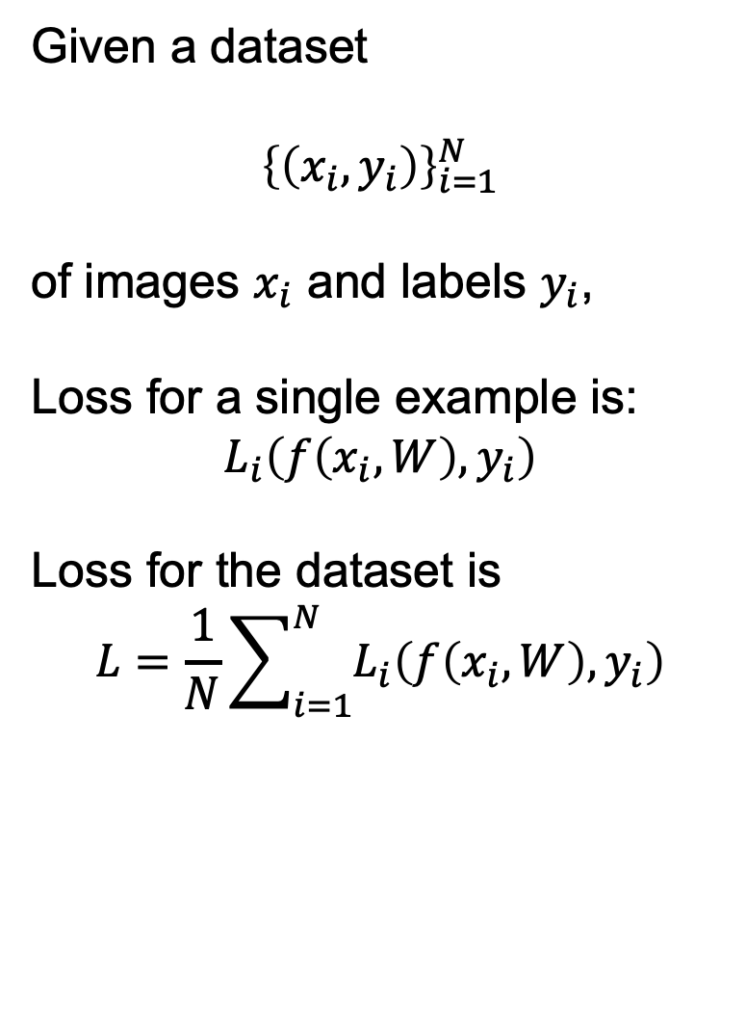
Choosing W: Loss Function
A loss function tells how good our current classifier is
Low loss = good classifier
High loss = bad classifier
(Also called: objective function; cost function)
Given a dataset
$${\left\{\left(x_{i}, y_{i}\right)\right\}}_{i=1}^{N}$$
of images $x_{i}$ and labels $y_{i}$,
Loss for a single example is:
$$L_{i}\left(f\left(x_{i}, W\right), y_{i}\right)$$
Loss for the dataset is
$$L=\frac{1}{N}\sum_{i=1}^{N}{L_{i}\left(f\left(x_{i}, W\right), y_{i}\right)}$$
Slide credit: D Fouhey & J Johnson

Slide 14
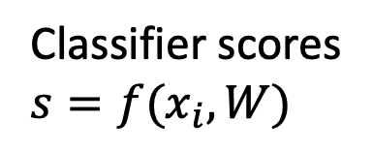
Cross-Entropy Loss
Want to interpret raw classifier scores as probabilities
Classifier scores
$s=f(x_{i},W)$
cat
3.2
car
5.1
frog
-1.7
Slide credit: D Fouhey & J Johnson

Slide 15
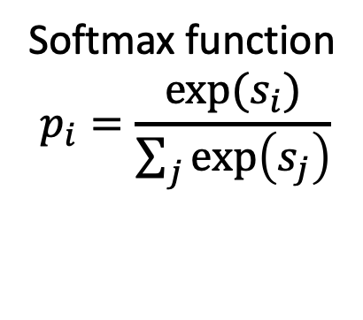
Cross-Entropy Loss
Want to interpret raw classifier scores as probabilities
Softmax function
$$p_{i}=\frac{exp⁡(s_{i})}{\sum_{j}{\exp\left(s_{j}\right)}}$$
Classifier scores
$s=f(x_{i},W)$
cat
3.2
car
5.1
frog
-1.7
Slide credit: D Fouhey & J Johnson

Slide 16
Cross-Entropy Loss
Want to interpret raw classifier scores as probabilities
Softmax function
$$p_{i}=\frac{exp⁡(s_{i})}{\sum_{j}{\exp\left(s_{j}\right)}}$$
Classifier scores
$s=f(x_{i},W)$
cat
3.2
car
5.1
frog
-1.7
Unnormalized log-probabilities / logits
Slide credit: D Fouhey & J Johnson

Slide 17
Cross-Entropy Loss
Want to interpret raw classifier scores as probabilities
Softmax function
$$p_{i}=\frac{exp⁡(s_{i})}{\sum_{j}{\exp\left(s_{j}\right)}}$$
Classifier scores
$s=f(x_{i},W)$
Probabilities must be >= 0
cat
3.2
24.5
exp
car
5.1
164
frog
-1.7
0.18
Unnormalized log-probabilities / logits
unnormalized probabilities
Slide credit: D Fouhey & J Johnson

Slide 18
Cross-Entropy Loss
Want to interpret raw classifier scores as probabilities
Softmax function
$$p_{i}=\frac{exp⁡(s_{i})}{\sum_{j}{\exp\left(s_{j}\right)}}$$
Classifier scores
$s=f(x_{i},W)$
Probabilities must be >= 0
Probabilities must sum to 1
cat
3.2
24.5
0.13
exp
normalize
car
5.1
164
0.87
frog
-1.7
0.18
0.00
Unnormalized log-probabilities / logits
unnormalized probabilities
probabilities
Slide credit: D Fouhey & J Johnson

Slide 19
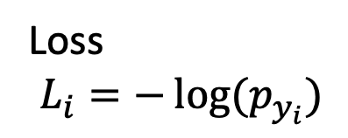
Cross-Entropy Loss
Want to interpret raw classifier scores as probabilities
Softmax function
$$p_{i}=\frac{exp⁡(s_{i})}{\sum_{j}{\exp\left(s_{j}\right)}}$$
Classifier scores
$s=f(x_{i},W)$
Loss
$$L_{i}=−\log{(p_{y_{i}})}$$
Probabilities must be >= 0
Probabilities must sum to 1
cat
3.2
24.5
0.13
L_{i} = -log(0.13)
= 2.04
exp
normalize
car
5.1
164
0.87
frog
-1.7
0.18
0.00
Unnormalized log-probabilities / logits
unnormalized probabilities
probabilities
Slide credit: D Fouhey & J Johnson

Slide 20
Cross-Entropy Loss
Want to interpret raw classifier scores as probabilities
Softmax function
$$p_{i}=\frac{exp⁡(s_{i})}{\sum_{j}{\exp\left(s_{j}\right)}}$$
Classifier scores
$s=f(x_{i},W)$
Loss
$$L_{i}=−\log{(p_{y_{i}})}$$
Probabilities must be >= 0
Probabilities must sum to 1
cat
3.2
24.5
0.13
L_{i} = -log(0.13)
= 2.04
exp
normalize
car
5.1
164
0.87
frog
-1.7
0.18
0.00
Maximum Likelihood Estimation
Choose weights to maximize the likelihood of the observed data
Unnormalized log-probabilities / logits
unnormalized probabilities
probabilities
Slide credit: D Fouhey & J Johnson

Slide 21
Today’s Class
Loss Function (quantify how good the model’s output are compared to the labels)
A bit more about cross-entropy loss
SVM (hinge) loss
Optimization (how to efficiently finding the parameters that minimize the loss function)
Gradient descent
SGD

Slide 22
Cross-Entropy Loss
Want to interpret raw classifier scores as probabilities
Softmax function
$$p_{i}=\frac{exp⁡(s_{i})}{\sum_{j}{\exp\left(s_{j}\right)}}$$
Classifier scores
$s=f(x_{i},W)$
Loss
$$L_{i}=−\log{(p_{y_{i}})}$$
Probabilities must be >= 0
Probabilities must sum to 1
cat
3.2
24.5
0.13
Compare
1.00
exp
normalize
car
5.1
164
0.87
0.00
frog
-1.7
0.18
0.00
0.00
Unnormalized log-probabilities / logits
unnormalized probabilities
Correct
probs
probabilities
Slide credit: D Fouhey & J Johnson

Slide 23


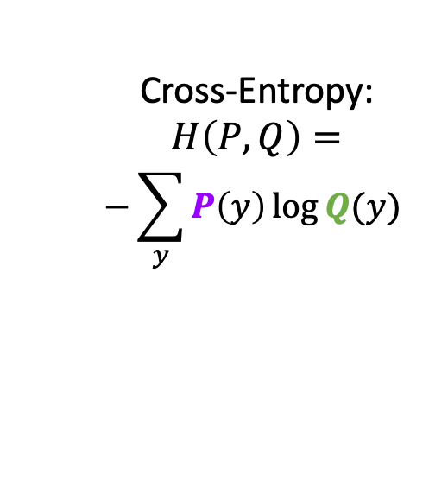
Cross-Entropy Loss
Want to interpret raw classifier scores as probabilities
Softmax function
$$p_{i}=\frac{exp⁡(s_{i})}{\sum_{j}{\exp\left(s_{j}\right)}}$$
Classifier scores
$s=f(x_{i},W)$
Loss
$$L_{i}=−\log{(p_{y_{i}})}$$
Probabilities must be >= 0
Probabilities must sum to 1
cat
3.2
24.5
0.13
Compare
1.00
exp
normalize
car
5.1
164
0.87
0.00
Cross-Entropy:
$$H\left(P, Q\right)=$$
$$−\sum_{y}{P\left(y\right)\log{Q(y)} }$$
frog
-1.7
0.18
0.00
0.00
Unnormalized log-probabilities / logits
unnormalized probabilities
Correct
probs
probabilities
$$Q$$
$$P$$
Slide credit: D Fouhey & J Johnson

Slide 24
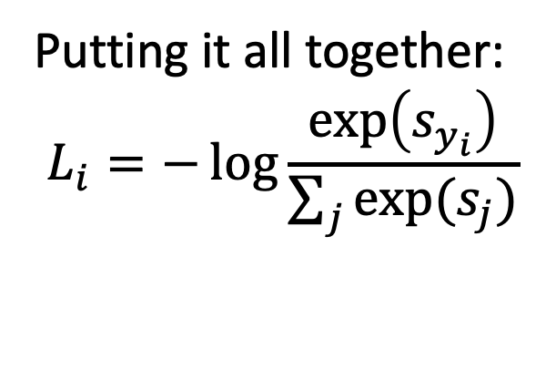
Cross-Entropy Loss
Want to interpret raw classifier scores as probabilities
Softmax function
$$p_{i}=\frac{exp⁡(s_{i})}{\sum_{j}{\exp\left(s_{j}\right)}}$$
Classifier scores
$s=f(x_{i},W)$
Loss
$$L_{i}=−\log{(p_{y_{i}})}$$
Putting it all together:
$$L_{i}=−\log{\frac{\exp\left(s_{y_{i}}\right)}{\sum_{j}{exp⁡(s_{j})}}}$$
cat
3.2
car
5.1
frog
-1.7
Slide credit: D Fouhey & J Johnson

Slide 25
Cross-Entropy Loss
Want to interpret raw classifier scores as probabilities
Softmax function
$$p_{i}=\frac{exp⁡(s_{i})}{\sum_{j}{\exp\left(s_{j}\right)}}$$
Classifier scores
$s=f(x_{i},W)$
Loss
$$L_{i}=−\log{(p_{y_{i}})}$$
Putting it all together:
$$L_{i}=−\log{\frac{\exp\left(s_{y_{i}}\right)}{\sum_{j}{exp⁡(s_{j})}}}$$
cat
3.2
car
5.1
frog
-1.7
Q: What is the min / max possible loss L_{i}?
Slide credit: D Fouhey & J Johnson

Slide 26
Cross-Entropy Loss
Want to interpret raw classifier scores as probabilities
Softmax function
$$p_{i}=\frac{exp⁡(s_{i})}{\sum_{j}{\exp\left(s_{j}\right)}}$$
Classifier scores
$s=f(x_{i},W)$
Loss
$$L_{i}=−\log{(p_{y_{i}})}$$
Putting it all together:
$$L_{i}=−\log{\frac{\exp\left(s_{y_{i}}\right)}{\sum_{j}{exp⁡(s_{j})}}}$$
cat
3.2
car
5.1
frog
-1.7
Q: If all scores are small random values, what is the loss?
Slide credit: D Fouhey & J Johnson

Slide 27
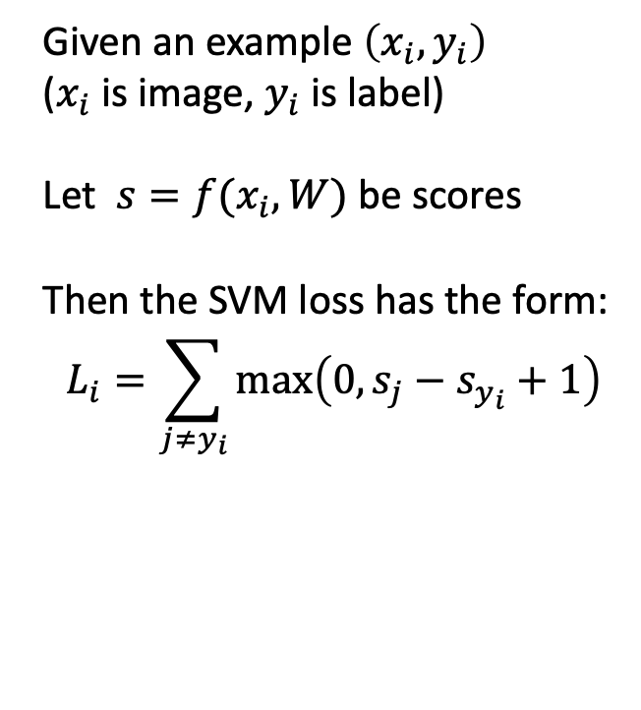
Multiclass SVM Loss
Given an example $\left(x_{i}, y_{i}\right)$
($x_{i}$is image, $y_{i}$is label)
Let $s=f(x_{i},W)$ be scores
Then the SVM loss has the form:
$$L_{i}=\sum_{j≠y_{i}}{\max\left(0, s_{j}−s_{y_{i}}+1\right)}$$
”The score of the correct class should be higher than all the other scores”
Loss
“Hinge Loss”
Score for correct class
Highest score among other classes
“Margin”
Slide credit: D Fouhey & J Johnson

Slide 28
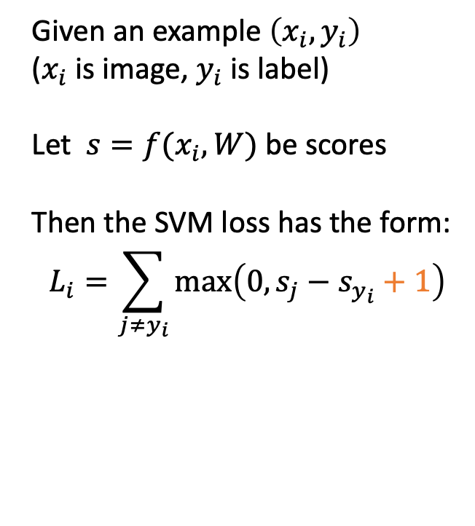
Multiclass SVM Loss
Given an example $\left(x_{i}, y_{i}\right)$
($x_{i}$is image, $y_{i}$is label)
Let $s=f(x_{i},W)$ be scores
Then the SVM loss has the form:
$$L_{i}=\sum_{j≠y_{i}}{\max\left(0, s_{j}−s_{y_{i}}+1\right)}$$
”The score of the correct class should be higher than all the other scores”
Loss
“Hinge Loss”
Score for correct class
margin
Highest score among other classes
“Margin”
Slide credit: D Fouhey & J Johnson

Slide 29
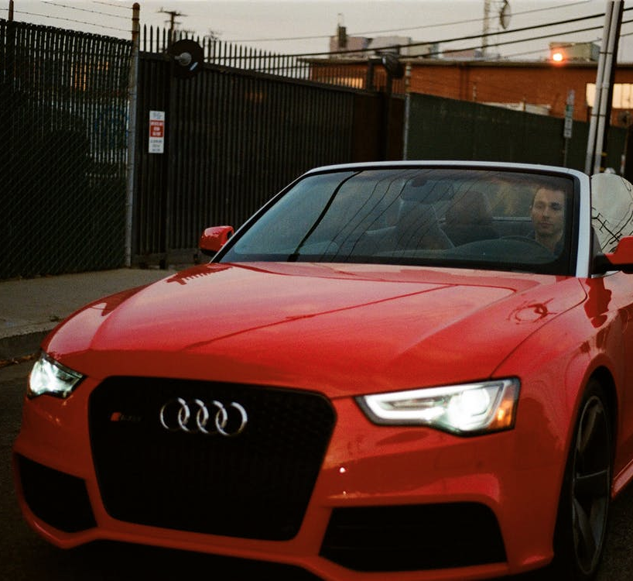
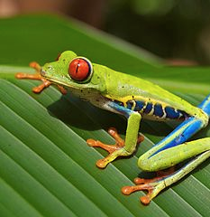
Multiclass SVM Loss
Given an example $\left(x_{i}, y_{i}\right)$
($x_{i}$is image, $y_{i}$is label)
Let $s=f(x_{i},W)$ be scores
Then the SVM loss has the form:
$$L_{i}=\sum_{j≠y_{i}}{\max\left(0, s_{j}−s_{y_{i}}+1\right)}$$
cat
3.2
1.3
2.2
car
5.1
4.9
2.5
frog
-1.7
2.0
-3.1
Slide credit: D Fouhey & J Johnson

Slide 30
Multiclass SVM Loss
Given an example $\left(x_{i}, y_{i}\right)$
($x_{i}$is image, $y_{i}$is label)
Let $s=f(x_{i},W)$ be scores
Then the SVM loss has the form:
$$L_{i}=\sum_{j≠y_{i}}{\max\left(0, s_{j}−s_{y_{i}}+1\right)}$$
cat
3.2
1.3
2.2
car
5.1
4.9
2.5
frog
-1.7
2.0
-3.1
Slide credit: D Fouhey & J Johnson

Slide 31
Multiclass SVM Loss
Given an example $\left(x_{i}, y_{i}\right)$
($x_{i}$is image, $y_{i}$is label)
Let $s=f(x_{i},W)$ be scores
Then the SVM loss has the form:
$$L_{i}=\sum_{j≠y_{i}}{\max\left(0, s_{j}−s_{y_{i}}+1\right)}$$
cat
3.2
1.3
2.2
car
5.1
4.9
2.5
= max(0, 5.1 - 3.2 + 1)
+ max(0, -1.7 - 3.2 + 1)
= max(0, 2.9) + max(0, -3.9)
= 2.9 + 0
= 2.9
frog
-1.7
2.0
-3.1
Loss
2.9
Slide credit: D Fouhey & J Johnson

Slide 32
Multiclass SVM Loss
Given an example $\left(x_{i}, y_{i}\right)$
($x_{i}$is image, $y_{i}$is label)
Let $s=f(x_{i},W)$ be scores
Then the SVM loss has the form:
$$L_{i}=\sum_{j≠y_{i}}{\max\left(0, s_{j}−s_{y_{i}}+1\right)}$$
cat
3.2
1.3
2.2
car
5.1
4.9
2.5
= max(0, 1.3 - 4.9 + 1)
+max(0, 2.0 - 4.9 + 1)
= max(0, -2.6) + max(0, -1.9)
= 0 + 0
= 0
frog
-1.7
2.0
-3.1
Loss
2.9
0
Slide credit: D Fouhey & J Johnson

Slide 33
Multiclass SVM Loss
Given an example $\left(x_{i}, y_{i}\right)$
($x_{i}$is image, $y_{i}$is label)
Let $s=f(x_{i},W)$ be scores
Then the SVM loss has the form:
$$L_{i}=\sum_{j≠y_{i}}{\max\left(0, s_{j}−s_{y_{i}}+1\right)}$$
cat
3.2
1.3
2.2
car
5.1
4.9
2.5
= max(0, 2.2 - (-3.1) + 1)
+max(0, 2.5 - (-3.1) + 1)
= max(0, 6.3) + max(0, 6.6)
= 6.3 + 6.6
= 12.9
frog
-1.7
2.0
-3.1
Loss
2.9
0
12.9
Slide credit: D Fouhey & J Johnson

Slide 34
Multiclass SVM Loss
Given an example $\left(x_{i}, y_{i}\right)$
($x_{i}$is image, $y_{i}$is label)
Let $s=f(x_{i},W)$ be scores
Then the SVM loss has the form:
$$L_{i}=\sum_{j≠y_{i}}{\max\left(0, s_{j}−s_{y_{i}}+1\right)}$$
cat
3.2
1.3
2.2
car
5.1
4.9
2.5
Loss over the dataset is:
L = (2.9 + 0.0 + 12.9) / 3
= 5.27
frog
-1.7
2.0
-3.1
Loss
2.9
0
12.9
Slide credit: D Fouhey & J Johnson

Slide 35
Multiclass SVM Loss
Given an example $\left(x_{i}, y_{i}\right)$
($x_{i}$is image, $y_{i}$is label)
Let $s=f(x_{i},W)$ be scores
Then the SVM loss has the form:
$$L_{i}=\sum_{j≠y_{i}}{\max\left(0, s_{j}−s_{y_{i}}+1\right)}$$
cat
3.2
1.3
2.2
car
5.1
4.9
2.5
frog
-1.7
2.0
-3.1
Q: What happens to the loss if the scores for the car image change a bit?
Loss
2.9
0
12.9
Slide credit: D Fouhey & J Johnson

Slide 36
Multiclass SVM Loss
Given an example $\left(x_{i}, y_{i}\right)$
($x_{i}$is image, $y_{i}$is label)
Let $s=f(x_{i},W)$ be scores
Then the SVM loss has the form:
$$L_{i}=\sum_{j≠y_{i}}{\max\left(0, s_{j}−s_{y_{i}}+1\right)}$$
cat
3.2
1.3
2.2
car
5.1
4.9
2.5
frog
-1.7
2.0
-3.1
Q: What are the min and max possible loss?
Loss
2.9
0
12.9
Slide credit: D Fouhey & J Johnson

Slide 37
Multiclass SVM Loss
Given an example $\left(x_{i}, y_{i}\right)$
($x_{i}$is image, $y_{i}$is label)
Let $s=f(x_{i},W)$ be scores
Then the SVM loss has the form:
$$L_{i}=\sum_{j≠y_{i}}{\max\left(0, s_{j}−s_{y_{i}}+1\right)}$$
cat
3.2
1.3
2.2
car
5.1
4.9
2.5
frog
-1.7
2.0
-3.1
Q: At initialization W is small so all s ≈ 0. What is the loss?
Loss
2.9
0
12.9
Slide credit: D Fouhey & J Johnson

Slide 38
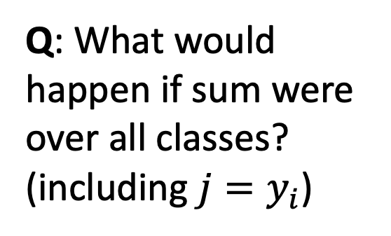
Multiclass SVM Loss
Given an example $\left(x_{i}, y_{i}\right)$
($x_{i}$is image, $y_{i}$is label)
Let $s=f(x_{i},W)$ be scores
Then the SVM loss has the form:
$$L_{i}=\sum_{j≠y_{i}}{\max\left(0, s_{j}−s_{y_{i}}+1\right)}$$
cat
3.2
1.3
2.2
car
5.1
4.9
2.5
frog
-1.7
2.0
-3.1
Q: What would happen if sum were over all classes? (including $j=y_{i}$)
Loss
2.9
0
12.9
Slide credit: D Fouhey & J Johnson

Slide 39
Multiclass SVM Loss
Given an example $\left(x_{i}, y_{i}\right)$
($x_{i}$is image, $y_{i}$is label)
Let $s=f(x_{i},W)$ be scores
Then the SVM loss has the form:
$$L_{i}=\sum_{j≠y_{i}}{\max\left(0, s_{j}−s_{y_{i}}+1\right)}$$
cat
3.2
1.3
2.2
car
5.1
4.9
2.5
frog
-1.7
2.0
-3.1
Q: What if the loss used mean instead of sum?
Loss
2.9
0
12.9
Slide credit: D Fouhey & J Johnson

Slide 40
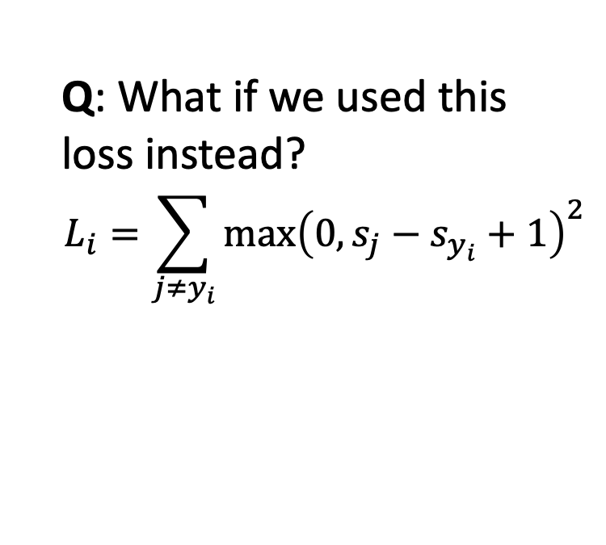
Multiclass SVM Loss
Given an example $\left(x_{i}, y_{i}\right)$
($x_{i}$is image, $y_{i}$is label)
Let $s=f(x_{i},W)$ be scores
Then the SVM loss has the form:
$$L_{i}=\sum_{j≠y_{i}}{\max\left(0, s_{j}−s_{y_{i}}+1\right)}$$
cat
3.2
1.3
2.2
car
5.1
4.9
2.5
frog
-1.7
2.0
-3.1
Q: What if we used this loss instead?
$$L_{i}=\sum_{j≠y_{i}}{\max{{\left(0, s_{j}−s_{y_{i}}+1\right)}^{2}}}$$
Loss
2.9
0
12.9
Slide credit: D Fouhey & J Johnson

Slide 41
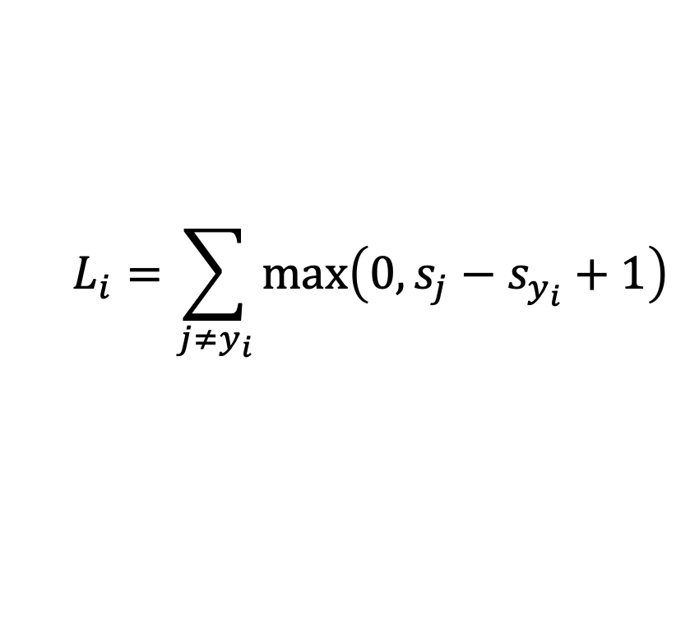
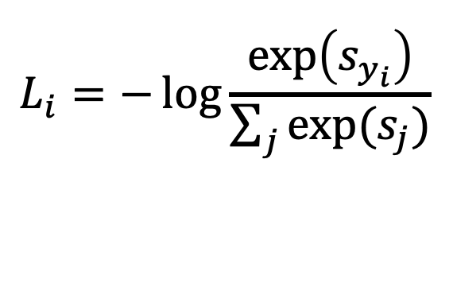
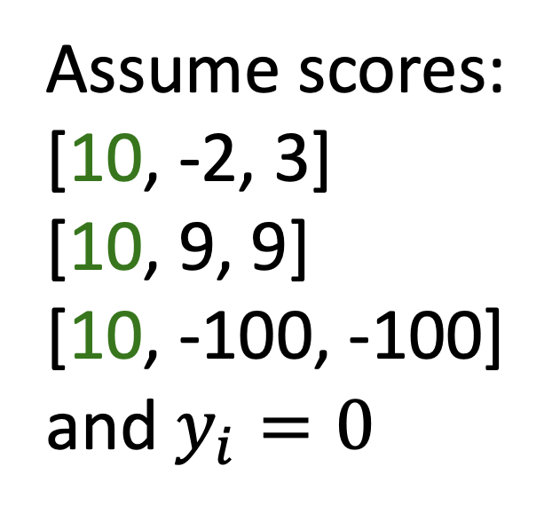
Cross-Entropy vs SVM Loss
$$L_{i}=−\log{\frac{\exp\left(s_{y_{i}}\right)}{\sum_{j}{exp⁡(s_{j})}}}$$
$$L_{i}=\sum_{j≠y_{i}}{\max\left(0, s_{j}−s_{y_{i}}+1\right)}$$
Assume scores:
[10, -2, 3]
[10, 9, 9]
[10, -100, -100]
and $y_{i}=0$
Q: What is cross-entropy loss? What is SVM loss?
A: Cross-entropy loss > 0
SVM loss = 0
Slide credit: D Fouhey & J Johnson

Slide 42
Cross-Entropy vs SVM Loss
$$L_{i}=−\log{\frac{\exp\left(s_{y_{i}}\right)}{\sum_{j}{exp⁡(s_{j})}}}$$
$$L_{i}=\sum_{j≠y_{i}}{\max\left(0, s_{j}−s_{y_{i}}+1\right)}$$
Assume scores:
[10, -2, 3]
[10, 9, 9]
[10, -100, -100]
and $y_{i}=0$
Q: What happens to each loss if I slightly change the scores of the last datapoint?
A: Cross-entropy loss will change; SVM loss will stay the same
Slide credit: D Fouhey & J Johnson

Slide 43
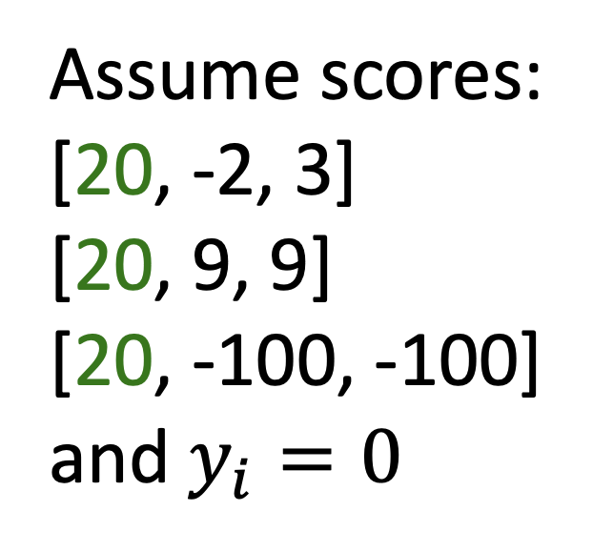
Cross-Entropy vs SVM Loss
$$L_{i}=−\log{\frac{\exp\left(s_{y_{i}}\right)}{\sum_{j}{exp⁡(s_{j})}}}$$
$$L_{i}=\sum_{j≠y_{i}}{\max\left(0, s_{j}−s_{y_{i}}+1\right)}$$
Assume scores:
[20, -2, 3]
[20, 9, 9]
[20, -100, -100]
and $y_{i}=0$
Q: What happens to each loss if I double the score of the correct class from 10 to 20?
A: Cross-entropy loss will decrease, SVM loss still 0
Slide credit: D Fouhey & J Johnson

Slide 44
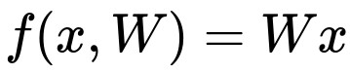

There is a “bug” with the hinge loss:
E.g. Suppose that we found a W such that L = 0.
Is this W unique?
Slide credit: E Learned-Miller, originally developed by A Karpathy, J Johnson, Fei-Fei L

Slide 45

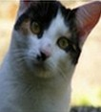

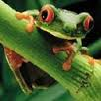
Suppose: 3 training examples, 3 classes.
With some W the scores are:
Before:
= max(0, 1.3 - 4.9 + 1)
+max(0, 2.0 - 4.9 + 1)
= max(0, -2.6) + max(0, -1.9)
= 0 + 0
= 0
cat
3.2
1.3
2.2
With W twice as large:
5.1
4.9
2.5
= max(0, 2.6 - 9.8 + 1)
+max(0, 4.0 - 9.8 + 1)
= max(0, -6.2) + max(0, -4.8)
= 0 + 0
= 0
car
-1.7
2.0
-3.1
frog
Losses:
2.9
0
12.9
Slide credit: E Learned-Miller, originally developed by A Karpathy, J Johnson, Fei-Fei L

Slide 46
An example:
What is the loss? (POLL)
cat
1.3
car
2.5
2.0
frog
Loss:
14
Slide credit: E Learned-Miller, originally developed by A Karpathy, J Johnson, Fei-Fei L

Slide 47
An example:
What is the loss?
cat
1.3
car
2.5
2.0
frog
Loss:
0.5
15
Slide credit: E Learned-Miller, originally developed by A Karpathy, J Johnson, Fei-Fei L

Slide 48
An example:
What is the loss? How could we change W to eliminate the loss? (POLL)
cat
1.3
car
2.5
2.0
frog
Loss:
0.5
16
Slide credit: E Learned-Miller, originally developed by A Karpathy, J Johnson, Fei-Fei L

Slide 49
An example:
What is the loss? How could we change W to eliminate the loss? (POLL) Multiply W (and b) by 2!
cat
1.3 2.6
car
2.5 5.0
2.0 4.0
frog
Loss:
0.5 0
17
Slide credit: E Learned-Miller, originally developed by A Karpathy, J Johnson, Fei-Fei L

Slide 50
An example:
What is the loss? How could we change W to eliminate the loss? (POLL) Multiply W (and b) by 2! Wait a minute! Have we done anything useful???
cat
1.3 2.6
car
2.5 5.0
2.0 4.0
frog
Loss:
0.5 0
18
Slide credit: E Learned-Miller, originally developed by A Karpathy, J Johnson, Fei-Fei L

Slide 51
An example:
What is the loss? How could we change W to eliminate the loss? (POLL) Multiply W (and b) by 2! Wait a minute! Have we done anything useful??? No! Any example that used to be wrong is still wrong (on the wrong side of the boundary). Any example that is right is still right (on the correct side of the boundary).
cat
1.3 2.6
car
2.5 5.0
2.0 4.0
frog
Loss:
0.5 0
19
Slide credit: E Learned-Miller, originally developed by A Karpathy, J Johnson, Fei-Fei L

Slide 52
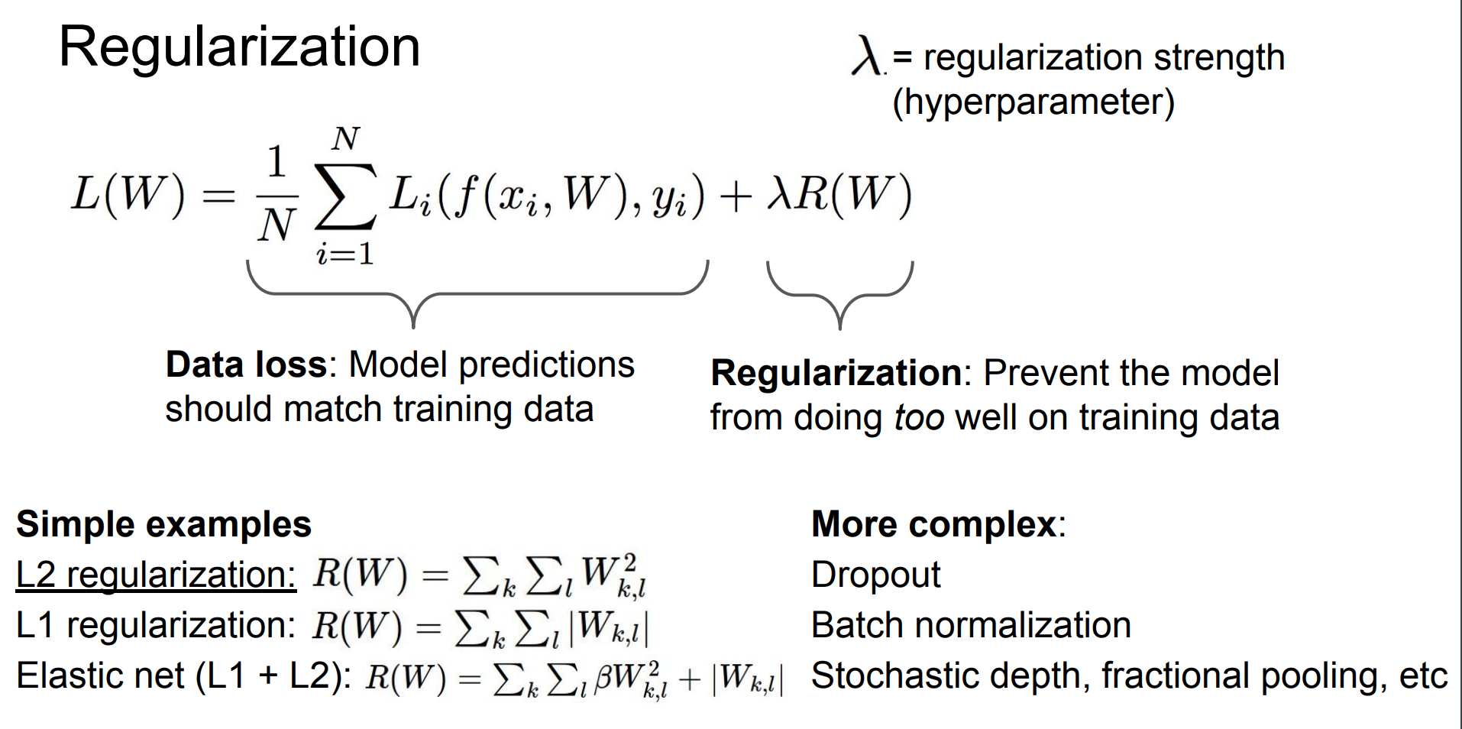
Regularization: Prevent the model from having too much flexibility.
Slide credit: E Learned-Miller, originally developed by A Karpathy, J Johnson, Fei-Fei L

Slide 53
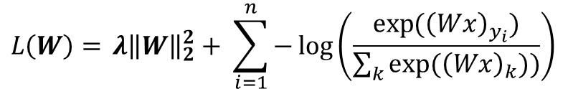
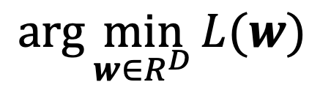
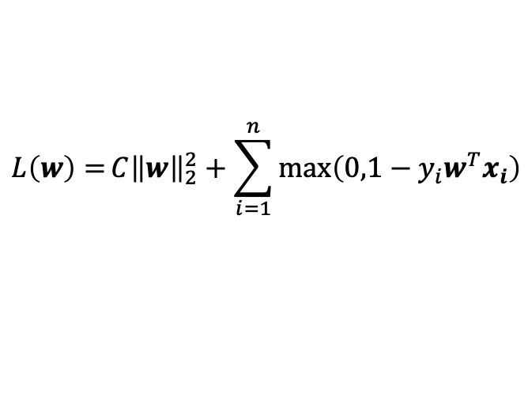
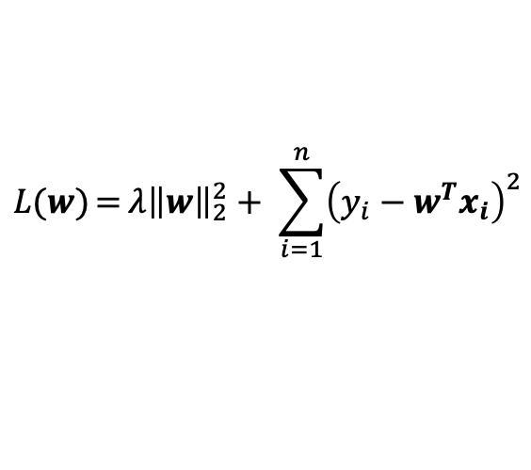
Optimization
Goal: find the w minimizing some loss function L.
$$\arg{\min_{w∈R^{D}}{L(w)}}$$
$${L\left(W\right)={λ{\left\|W\right\|}_{2}^{2}+ \sum_{i=1}^{n}{−\log\left(\frac{\exp{({\left(Wx\right)}_{y_{i}})}}{\sum_{k}{exp⁡({\left(Wx\right)}_{k}))}}\right)}}}$$
Works for lots of different Ls:
$$L\left(w\right)={C{\left\|w\right\|}_{2}^{2}+\sum_{i=1}^{n}{max⁡\left(0,1−y_{i}w^{T}x_{i}\right)}}$$
$$L(w){={λ{\left\|w\right\|}_{2}^{2}+ \sum_{i=1}^{n}{{\left(y_{i}−w^{T}x_{i}\right)}^{2}}}}$$
Slide credit: D Fouhey & J Johnson

Slide 54
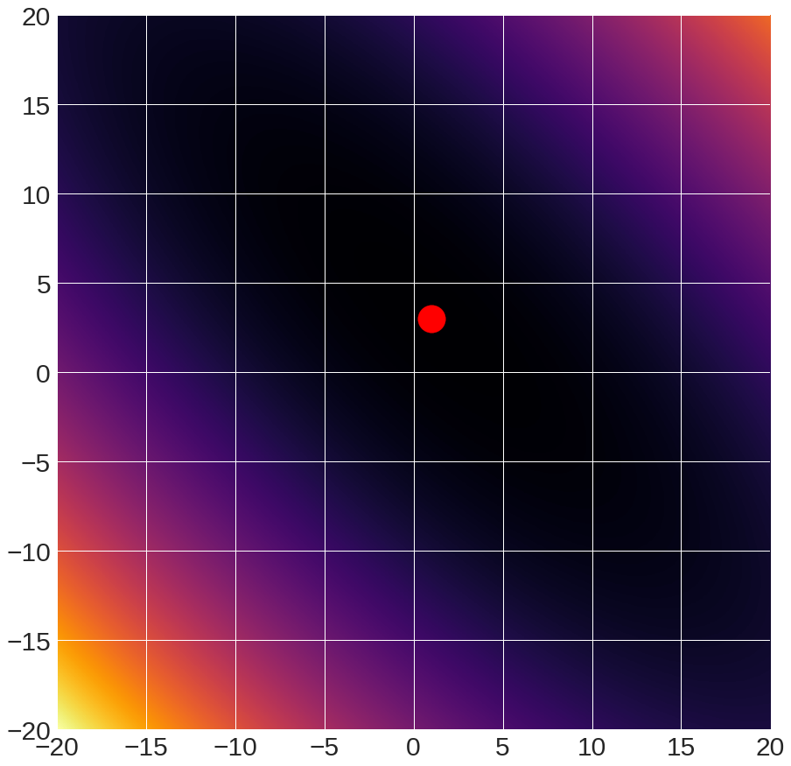
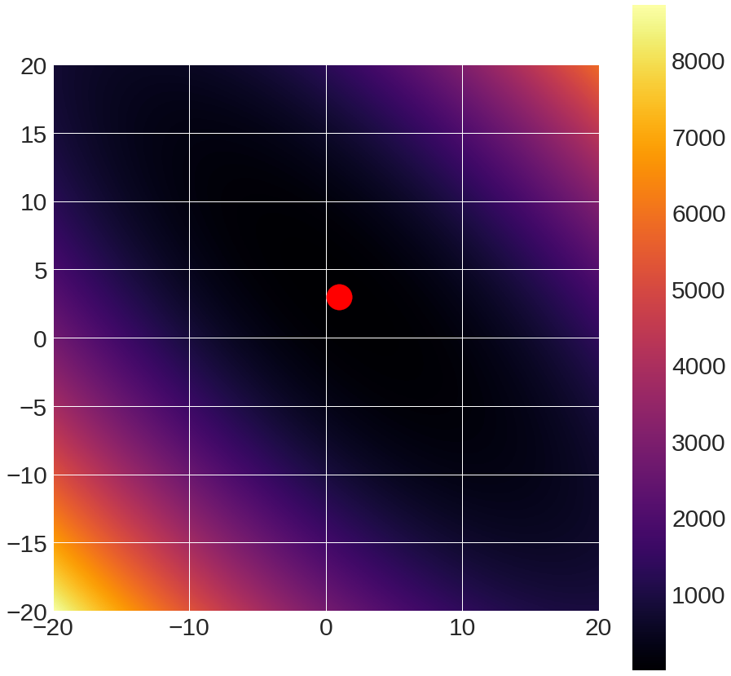
Sample Function to Optimize
f(x,y) = (x+2y-7)² + (2x+y-5)²
Global minimum
Warning: This is 2D, intuition may not generalize to high dimension
Slide credit: D Fouhey & J Johnson

Slide 55
Optimization: A Caveat
Each point in the picture is a function evaluation
Here it takes microseconds – so we can easily see the answer
Functions we want to optimize may take hours to evaluate
Slide credit: D Fouhey & J Johnson

Slide 56
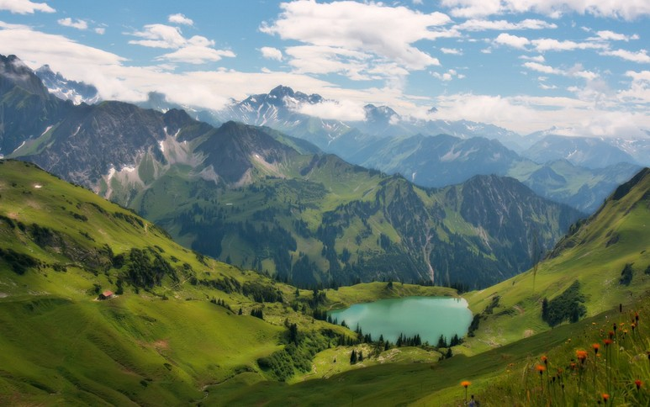
Slide credit: E Learned-Miller, originally developed by A Karpathy, J Johnson, Fei-Fei L

Slide 57

Slide credit: E Learned-Miller, originally developed by A Karpathy, J Johnson, Fei-Fei L

Slide 58
Idea #1A: Grid Search
#systematically try things
best, bestScore = None, Inf
for dim1Value in dim1Values:
….
for dimNValue in dimNValues:
w = [dim1Value, …, dimNValue]
if L(w) < bestScore:
best, bestScore = w, L(w)
return best
Slide credit: D Fouhey & J Johnson

Slide 59
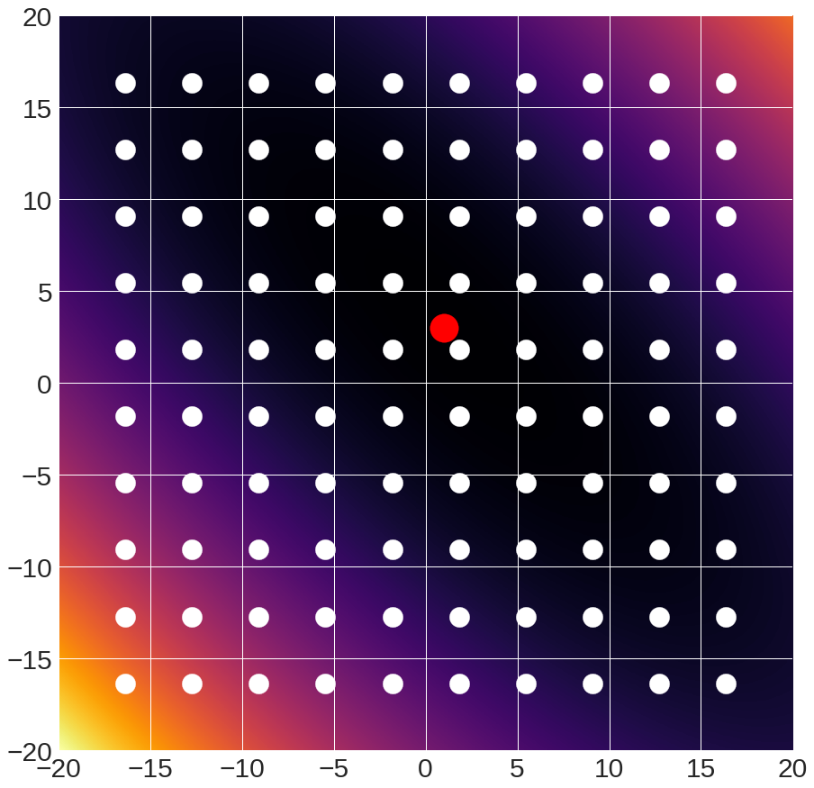
Idea #1A: Grid Search
Slide credit: D Fouhey & J Johnson

Slide 60
Idea #1A: Grid Search
Pros:
Super simple
Only requires being able to evaluate model
Cons:
Scales horribly to high dimensional spaces
Complexity: samplesPerDim^{numberOfDims}
Slide credit: D Fouhey & J Johnson

Slide 61
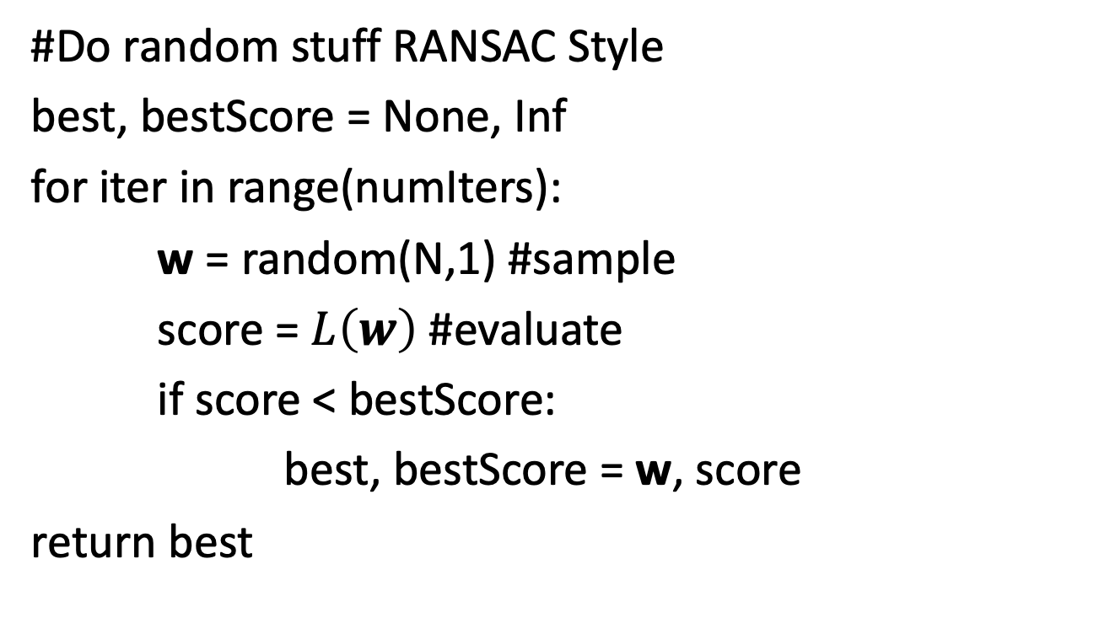
Option #1B: Random Search
#Do random stuff RANSAC Style
best, bestScore = None, Inf
for iter in range(numIters):
w = random(N,1) #sample
score = $L\left(w\right)$ #evaluate
if score < bestScore:
best, bestScore = w, score
return best
Slide credit: D Fouhey & J Johnson

Slide 62
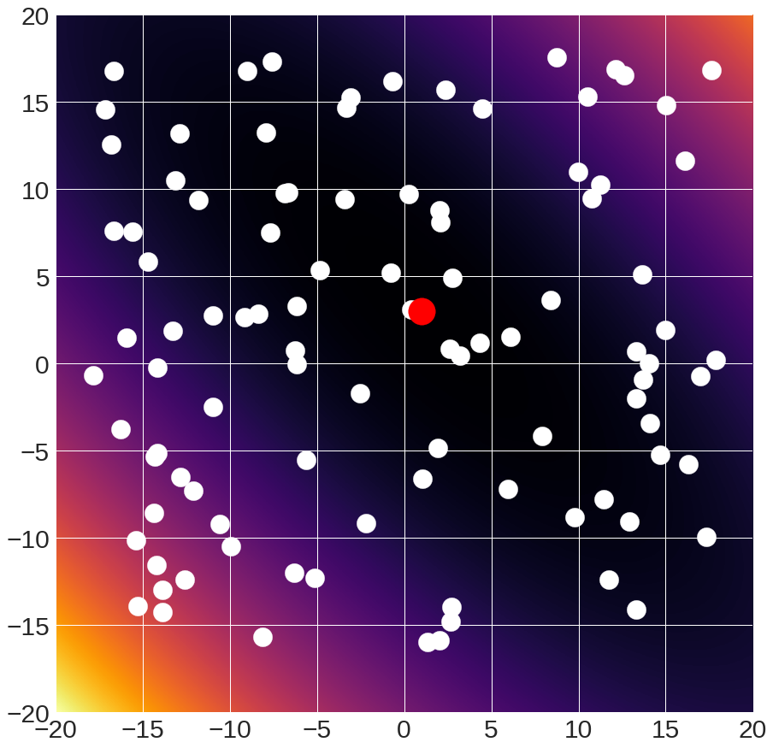
Option #1B: Random Search
Slide credit: D Fouhey & J Johnson

Slide 63
Option #1B: Random Search
Pros:
Super simple
Only requires being able to sample model and evaluate it
Cons:
Slow –throwing darts at high dimensional dart board
Might miss something
P(all correct) =
ε^{N}
ε
Good parameters
All parameters
0
1
Slide credit: D Fouhey & J Johnson

Slide 64
When To Use Options 1A / 1B?
Use these when
Number of dimensions small, space bounded
Objective is impossible to analyze
Random search is arguably more effective; grid search makes it easy to systematically test something (people love certainty)
Slide credit: D Fouhey & J Johnson

Slide 65
Idea #2: Follow the slope
Slide credit: E Learned-Miller, originally developed by A Karpathy, J Johnson, Fei-Fei L

Slide 66
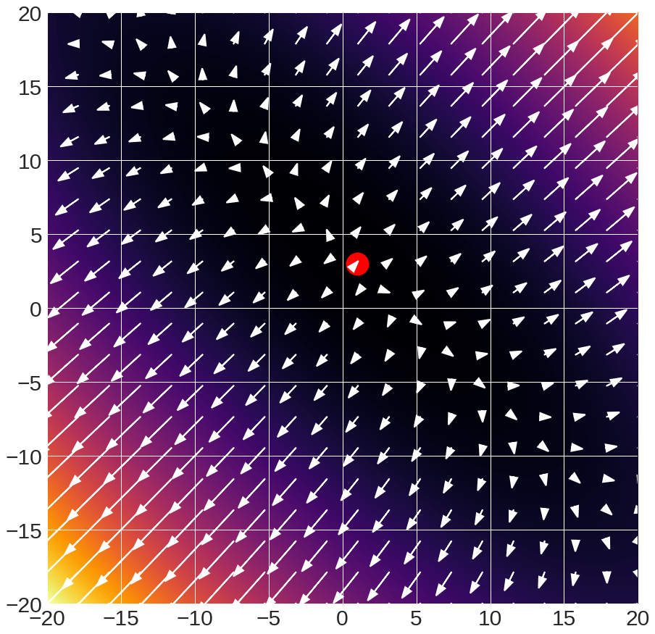
Idea #2: Follow the slope
Arrows:
gradient
Slide credit: D Fouhey & J Johnson

Slide 67
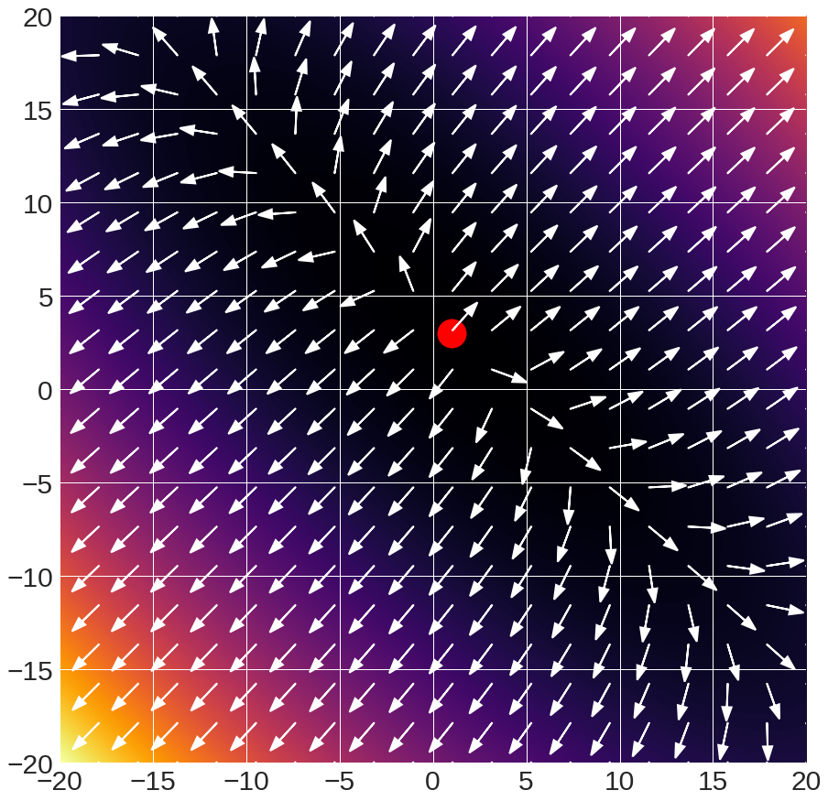
Idea #2: Follow the slope
Arrows:
gradient direction
(scaled to unit length)
Slide credit: D Fouhey & J Johnson

Slide 68






Idea #2: Follow the slope
Want:
$$\arg{\min_{w}{L(w)}}$$
$$∇_{w}L\left(w\right)=\left[\begin{matrix}∂L/∂x_{1} \\ ⋮ \\ ∂L/∂x_{N}\end{matrix}\right]$$
What’s the geometric interpretation of:
Which is bigger (for small α)?
$$≤?$$
$$L\left(w\right)$$
$$L\left(w+{α∇}_{w}L(w)\right)$$
$$>?$$
Slide credit: D Fouhey & J Johnson

Slide 69

Idea #2: Follow the slope
Method: at each step, move in direction of negative gradient
w0 = initialize() #initialize
for iter in range(numIters):
g = $∇_{w}L\left(w\right)$ # eval gradient
w = w + -stepsize*g # update w
return w
Slide credit: D Fouhey & J Johnson

Slide 70


Gradient Descent
Given starting point (blue)
w_{i+1} = w_{i} + -9.8x10⁻² * gradient
Slide credit: D Fouhey & J Johnson

Slide 71



Computing Gradients: Numeric
How Do You Compute The Gradient?
Numerical Method:
How do you compute this?
$$∇_{w}L\left(w\right)=\left[\begin{matrix}\frac{∂L(w)}{∂w_{1}} \\ ⋮ \\ \frac{∂L(w)}{∂w_{n}}\end{matrix}\right]$$
$$\frac{∂f(x)}{∂x}=\lim_{ε→0}{\frac{f\left(x+ε\right)−f(x)}{ε}}$$
In practice, use:
$$\frac{f\left(x+ε\right)−f\left(x−ε\right)}{2ε}$$
Slide credit: D Fouhey & J Johnson

Slide 72


Computing Gradients: Numeric
How Do You Compute The Gradient?
Numerical Method:
Use:
$$\frac{f\left(x+ε\right)−f\left(x−ε\right)}{2ε}$$
$$∇_{w}L\left(w\right)=\left[\begin{matrix}\frac{∂L(w)}{∂x_{1}} \\ ⋮ \\ \frac{∂L(w)}{∂x_{n}}\end{matrix}\right]$$
How many function
evaluations per dimension?
Slide credit: D Fouhey & J Johnson

Slide 73


Computing Gradients: Analytic
How Do You Compute The Gradient?
Better Idea: Use Calculus!
$$∇_{w}L\left(w\right)=\left[\begin{matrix}\frac{∂L(w)}{∂x_{1}} \\ ⋮ \\ \frac{∂L(w)}{∂x_{n}}\end{matrix}\right]$$
This image is in the public domain
This image is in the public domain
Slide credit: D Fouhey & J Johnson

Slide 74

Developed calculus
Fundamentals of optics
Theory of gravity
Slide credit: E Learned-Miller

Slide 75

Computing Gradients
Numeric gradient: approximate, slow, easy to write
Analytic gradient: exact, fast, error-prone
In practice: Always use analytic gradient, but check implementation with numerical gradient. This is called a gradient check.
Slide credit: D Fouhey & J Johnson

Slide 76


Gradient Descent
negative gradient direction
Iteratively step in the direction of the negative gradient
(direction of local steepest descent)
W_2
original W
Hyperparameters:
Weight initialization method
Number of steps
Learning rate
W_1
Slide credit: D Fouhey & J Johnson

Slide 77


Batch Gradient Descent
$$L\left(W\right)=\frac{1}{N}\sum_{i=1}^{N}{L_{i}\left(x_{i},y_{i}, W\right)+λR(W)}$$
Problem: Full sum is expensive when N is large!
Solution: Approximate sum using a minibatch of examples, e.g. 32
$$∇_{W}L\left(W\right)=\frac{1}{N}\sum_{i=1}^{N}{{∇_{W}L}_{i}\left(x_{i},y_{i}, W\right)+λ∇_{W}R(W)}$$
Slide credit: D Fouhey & J Johnson

Slide 78

Stochastic Gradient Descent (SGD)
$$L\left(W\right)=\frac{1}{N}\sum_{i=1}^{N}{L_{i}\left(x_{i},y_{i}, W\right)+λR(W)}$$
Problem: Full sum is expensive when N is large!
Solution: Approximate sum using a minibatch of examples, e.g. 32
$$∇_{W}L\left(W\right)=\frac{1}{N}\sum_{i=1}^{N}{{∇_{W}L}_{i}\left(x_{i},y_{i}, W\right)+λ∇_{W}R(W)}$$
Hyperparameters:
Weight initialization
Number of steps
Learning rate
Batch size
Data sampling
Slide credit: D Fouhey & J Johnson

Slide 79



Gradient Descent: Learning Rate
Step size (also called learning rate / lr)
critical parameter
1x10⁻²
10x10⁻²
12x10⁻²
falls short
converges
diverges
Slide credit: D Fouhey & J Johnson

Slide 80

Gradient Descent: Learning Rate
11x10⁻² :oscillates
Slide credit: D Fouhey & J Johnson

Slide 81

Effects of Learning Rate (Step Size)
Slide credit: E Learned-Miller

Slide 82


Learning Rate Decay
Idea: Start with high learning rate, reduce it over time.
Step Decay: Reduce by some factor at fixed iterations
Slide credit: D Fouhey & J Johnson

Slide 83



Learning Rate Decay
Idea: Start with high learning rate, reduce it over time.
Cosine Decay: $α_{t}=\frac{1}{2}α_{0}\left(1+cos\left(\frac{tπ}{T}\right)\right)$
Slide credit: D Fouhey & J Johnson

Slide 84
Problems with SGD
What if loss changes quickly in one direction and slowly in another?
Loss function has high condition number: ratio of largest to smallest singular value of the Hessian matrix is large
Slide credit: D Fouhey & J Johnson

Slide 85
Problems with SGD
What if loss changes quickly in one direction and slowly in another?
Slow progress along shallow dimension, jitter along steep direction
Loss function has high condition number: ratio of largest to smallest singular value of the Hessian matrix is large
Slide credit: D Fouhey & J Johnson

Slide 86

Problems with SGD
Local Minimum
What if the loss function has a local minimum or saddle point?
Saddle point
Gradient is zero, SGD gets stuck
Slide credit: D Fouhey & J Johnson

Slide 87


Problems with SGD
Our gradients come from minibatches so they can be noisy!
$$L\left(W\right)=\frac{1}{N}\sum_{i=1}^{N}{L_{i}\left(x_{i},y_{i}, W\right)+λR(W)}$$
Slide credit: D Fouhey & J Johnson

Slide 88


SGD
SGD
$$x_{t+1}=x_{t}−α∇f\left(x_{t}\right)$$
Sutskever et al, “On the importance of initialization and momentum in deep learning”, ICML 2013
Slide credit: D Fouhey & J Johnson

Slide 89



SGD + Momentum
SGD
SGD + Momentum
$$v_{t+1}=ρv_{t}+∇f\left(x_{t}\right)$$
$$x_{t+1}=x_{t}−αv_{t+1}$$
$$x_{t+1}=x_{t}−α∇f\left(x_{t}\right)$$
Build up “velocity” as a running mean of gradients
Rho gives “friction”; typically $ρ=0.9$ or 0.99
Sutskever et al, “On the importance of initialization and momentum in deep learning”, ICML 2013
Slide credit: D Fouhey & J Johnson

Slide 90


SGD + Momentum
SGD + Momentum
SGD + Momentum
$$v_{t+1}=ρv_{t}−α∇f\left(x_{t}\right)$$
$$x_{t+1}=x_{t}+v_{t+1}$$
$$v_{t+1}=ρv_{t}+∇f\left(x_{t}\right)$$
$$x_{t+1}=x_{t}−αv_{t+1}$$
You may see SGD+Momentum formulated different ways, but they are equivalent - give same sequence of x
Sutskever et al, “On the importance of initialization and momentum in deep learning”, ICML 2013
Slide credit: D Fouhey & J Johnson

Slide 91

SGD + Momentum
Gradient Noise
Local Minima
Saddle points
Poor Conditioning
SGD
SGD+Momentum
Sutskever et al, “On the importance of initialization and momentum in deep learning”, ICML 2013
Slide credit: D Fouhey & J Johnson

Slide 92

The effects of different update form formulas
(image credits to Alec Radford)
Slide credit: E Learned-Miller

Slide 93
Optimization in Practice
Conventional wisdom: minibatch stochastic gradient descent (SGD) + momentum (package implements it for you) + some sensibly changing learning rate
The above is typically what is meant by “SGD”
Other update rules exist (Adam very common); sometimes better, sometimes worse than SGD
Slide credit: D Fouhey & J Johnson

Slide 94


Optimizing Everything
$${L\left(W\right)={λ{\left\|W\right\|}_{2}^{2}+ \sum_{i=1}^{n}{−\log\left(\frac{\exp{({\left(Wx\right)}_{y_{i}})}}{\sum_{k}{exp⁡({\left(Wx\right)}_{k}))}}\right)}}}$$
$$L(w){={λ{\left\|w\right\|}_{2}^{2}+ \sum_{i=1}^{n}{{\left(y_{i}−w^{T}x_{i}\right)}^{2}}}}$$
Optimize w on training set with SGD to maximize training accuracy
Optimize λ with random/grid search to maximize validation accuracy
Note: Optimizing λ on training sets it to 0
Slide credit: D Fouhey & J Johnson

Slide 95
Next Class
Neural Networks!

